Slide 1
COMP 2100
Week 12 - Friday

Slide 2
Last time
What did we talk about last time?
Sorting
Insertion sort
Merge sort

Slide 3
Questions?

Slide 4
Project 4

Slide 5
Assignment 6

Slide 6
Exam 2 Post Mortem

Slide 7
Quicksort

Slide 8
Quicksort
Pros:
  Best and average case running time of
  O(n log n)
  Very simple implementation
  In-place
  Ideal for arrays
Cons:
  Worst case running time of O(n²)
  Not stable

Slide 9
Quicksort algorithm
Pick a pivot
Partition the array into a left half smaller than the pivot and a right half bigger than the pivot
Recursively, quicksort the left half
Recursively quicksort the right half

Slide 10
Partition algorithm
Input: array, index, left, right
Set pivot to be array[index]
Swap array[index] with array[right]
Set index to left
For i from left up to right – 1
  If array[i] ≤ pivot
    Swap array[i] with array[index]
    index++
Swap array[index] with array[right]
Return index //so that we know where pivot is

Slide 11
Quicksort Example
7
45
0
0
7
54
45
37
54
108
37
0
108
7
0
37
7
45
0
37
54
7
45
108
37
54
45
0
7
0
108
54
108
45
7
54
37
37
45
108
54
108

Slide 12
Quicksort issues
Everything comes down to picking the right pivot
  If you could get the median every time, it would be great
A common choice is the first element in the range as the pivot
  Gives O(n²) performance if the list is sorted (or reverse sorted)
  Why?
Another implementation is to pick a random location
Another well-studied approach is to pick three random locations and take the median of those three
An algorithm exists that can find the median in linear time, but its constant is HUGE

Slide 13
Lower Bound on Sorting

Slide 14
The fastest sort
How many ways are there to order n items?
n different things can go in the first position, leaving n – 1 to go in the second position, leaving n – 2 things to go into the third position…
n (n – 1) (n – 2) … (2)(1) = n!
In other words, there are n! different orderings, and we have to do some work to find the ordering that puts everything in sorted order

Slide 15
A different kind of tree
Imagine a tree of decisions
Some sequence of decisions will lead to a leaf of the tree
Each leaf of the tree represents one of those n! orders
n!

Slide 16
Tree height
What is the smallest height the tree could have?
A perfectly balanced binary tree with k leaves will have a height of log₂(k)
Since we have n! leaves, the smallest height will be log₂(n!)
log(n!)
n!

Slide 17
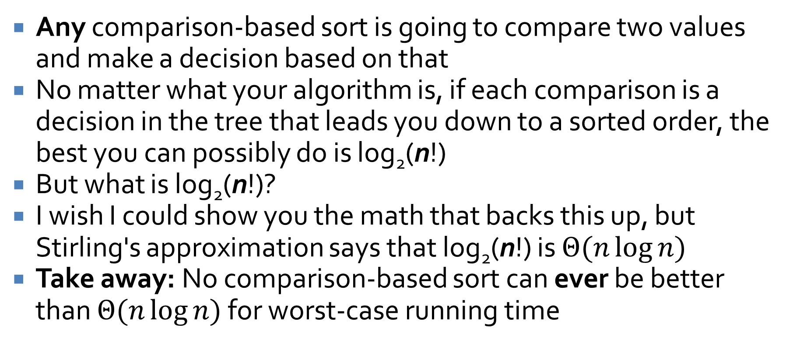
Comparison-based sorts
Any comparison-based sort is going to compare two values and make a decision based on that
No matter what your algorithm is, if each comparison is a decision in the tree that leads you down to a sorted order, the best you can possibly do is log₂(n!)
But what is log₂(n!)?
I wish I could show you the math that backs this up, but Stirling's approximation says that log₂(n!) is $Θ(n\log{n)}$
Take away: No comparison-based sort can ever be better than $Θ(n\log{n)}$ for worst-case running time

Slide 18
Quiz

Slide 19
Upcoming

Slide 20
Next time…
Counting sort
Radix sort
Heaps
Heapsort
TimSort

Slide 21
Reminders
Work on Project 4
Finish Assignment 6
  Due tonight by midnight!
Read Section 2.4

